Slide 1
Borehole Microseismic Survey Design and Processing Overview
For more information visit www.keburns.com
Report by Kevin Burns
Feb. 2019

Slide 2
Purpose
This PowerPoint presentation is intended to be used as an introduction into the steps taken when deciding to monitor the hydraulic fracture completions of a well, how to design the array, and what to look out for.
The ancillary goal of this presentation is to better educate the end-users of microseismic monitoring to improve the QC process as most QC is performed by the same firm that both acquires and processes the data.

Slide 3
Why monitor a hydraulic fracture completions?
Ideally, all well would be great candidates for monitoring but costs, logistics will play a significant role in which wells to choose and why. Special care needs to be considered for what monitoring can provide and what it cannot beyond the marketing hype.
Microseismic can provide the following:
  SH_{MAX} direction, fracture properties (half-length, height, width), crosswell communication, event properties (size, magnitude, moment tensor, etc.), identify hazards (e.g. faulting, packer isolation failure, leaks) verify completions (stage isolation, symmetry, preferential fracture features, out-of-zone propagation, frac effectiveness, magnitude for regulations.

Slide 4
Why not to monitor hydraulic fracture completions?
The monitor well is poorly suited to the project goals (more on this later)
The geology if less than ideal (high signal attenuation/ductile formation)
You don’t care about the results
Microseismic monitoring cannot (currently) provide the following:
  Total volume of created fracture/void space, a delineation between propped and unpropped fracture events, fluid content

Slide 5
Will this project be successful?
In most cases, one can pre-determine the success of a monitoring project even before the acquisition by exploring projects which have been previously performed in the region, evaluating well conditions, evaluating monitor well suitability.
There are pre-job modeling software packages which attempt to simulate the expected results and are often a poor indicator of success, but with pretty, colorful pictures. Prior field experience or finding an analogues formation is often a better indicator for success.
  A better estimate can be found HERE

Slide 6
Selecting a Monitor Well
Well Distance – how does the field transmit energy over distance?
  (click here for a guide)
Direction of SH_{MAX} - will the monitor well be impacted by the stimulation?
  Unsure of direction? Discuss Here
Will the position of the well create an asymmetrical bias?
Condition of the well (casing, perforation depth)
Economics

Slide 7
Monitoring Equipment Basics
There are several commercially developed geophones specifically designed for acquiring data within a borehole setting each with their own advantages and drawbacks. (for more detailed discussion click here)
Each tool must be coupled or connected the wellbore in order to receive good signal from the source fracture event
Oyo Geospace DS150 is the standard tool that is deployed via a fiber optic wireline within the wellbore. This tool can be use mechanical bowsprings or magnetic clamping to couple to the wellbore.

Slide 8
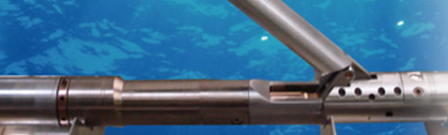
Monitoring Equipment Basics
Oyo Geospace DS250 is a larger tool that features multiple geophones per axis effectively stacking the tool and uses a mechanical clamping arm, deployed on a fiber optic wireline.
Sercel offers a series of tools including the Slimwave which is one of the smallest borehole tools on the market and uses a mechanical actuator to achieve coupling with the wellbore. Tools are upgradeable for internal stacking. This can be deployed on a conventional wireline unit. The
Avalon Geochain series is the industry go-to for higher temperature borehole geophones and couples via a mechanical clamping arm, is also upgradeable for internal stacking.
Sercel SlimWave with clamping arm

Slide 9
Geophone Array Design
Geophone arrays are ideally designed based on individual projects goals in mind and within the logistical limitations of each individual project
  The number of tools and recorded sampling rates have more to do with advertising than with data quality (future discussion point)
Special considerations should be made for the following circumstances
  Monitor well is also a producing well with a plug (very common)
  Monitor well does not have a deviation survey (very common)
  Monitor well has poorly defined cement (from CBL – cement bond log) Equipment placed in a this section is effectively decoupled from the formation, signal will be poor to non-existent if the tool is placed >10 ft from cemented section (sometimes this is unavoidable)

Slide 10
Geophone Orientation
For traditional microseismic operations we require a known source for orientating the geophones (a.k.a levels or tools).
Orientation shots can include one or more of the following:
  Perforation shot(s)
  Stringshot(s)
  Vibroseis
  Early event(s)
As the array is deployed in the wellbore, most tools can spin along a flexible interconnect and thus can be pointed in various directions. This is not a problem as the orientation process determines how the individual tool direction.

Slide 11
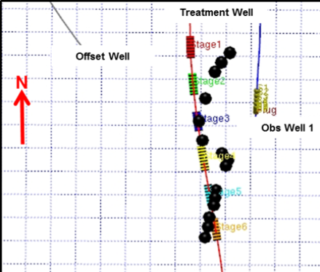
Geophone Orientation Quality Control
Once the geophone array (a.k.a. toolstring) is oriented these orientations need to be checked against known shots or assumed early events (assumptions based on individual project).
Orientation drift can be observed in the plots and are resolved by the processing staff. The most common source of error is due to well head coordinates.
  Sample image is oriented on stage 3 middle event, note the orientation drifting as the result of a significant well head error.

Slide 12
Geophone Orientation Quality Control
A summary list of all geophone orientations are plotted and analyzed for consistency. If possible, an average is taken and some geophones tools (noisy tool on a particular shot) are removed from averaging.
  If a particular geophone is displaying a high level of noise, the geophone may be removed from orientations but can still be used for event location (distance and depth). Review the CBL for the monitor well.
Unstable orientations are typically the result of incorrect wellhead locations (most common, example in previous slide), unaccounted/unknown deviation within the monitoring well, and error within the treatment well.

Slide 13
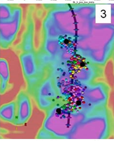
180 Degree Ambiguity – When to flip?
At times there are some inherent ambiguities when locating microseismic data and assumptions need to be made based on other criteria to account for this ambiguity.
Note the image sourced from the Hayles et al. paper to the right depicts events that tend to occur around the monitor well and not near the wellbore. These events should be relocated. Discussed further here.
Examples of other tools include
  Examining event fracture propagation sequence
  Comparison with event distribution of other stages
  Event attributes

Slide 14
Velocity Modeling
Velocity models are typically constructed around a combination of formation tops, sonic logs, anisotropic parameters, and layering tilt.
Models are then updated using manual or tomographic procedures on calibration events (typically perfs, string shots, ball hits, or early events)
Special care needs to be taken with modeling as various location methods can create stacking artifacts (events trapped on velocity boundaries). Mitigation steps include introducing step-wise intervals, filtering (weighted averaging) of the velocities, etc.

Slide 15
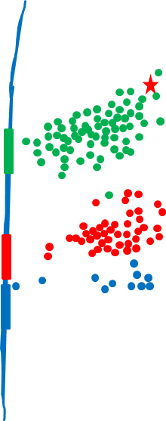
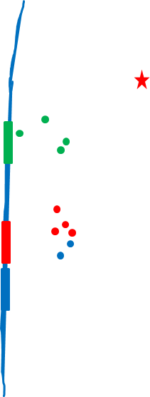
Examples of Poor Modeling
Events centered off wellbore
Perforation Events
Monitor Well

Slide 16
Velocity Modeling Quality Control
Special care is taken when adjusting the modeled values to fit the calibration shots
  Checks are run for artifacts generated by layered modeling (may not be apparent for individual stages/calibrations events)
  Adjustments are made in small increments
  Minimization of number of models (if numerous models are used why?)
    Models adjusted on a per stage basis indicate poor control)
    Investigate how layered velocities are changing in each layer or how layer thickness is changing

Slide 17
Event Locations
Receiver
Why do some stages have more events than others?
Why are some stage events in the wrong place after calibration verified?
Should I assume symmetry around the wellbore?
Why are the waveform moveouts important?

Slide 18
Out of Position Events
Possible Causes
  Faulting
  Communication with nearby well
  Communication with previous stimulation
  Dominate single perfs (compare with MWD Gamma log)
  Well-related issues (Poor packer isolation, premature sleeve opening, etc.)
Non-connected events
  It is not uncommon to locate events which appear unconnected to the cloud of events. This can happen if the stimulation migrates through a ductile zone or when connected to a fault. Reviewing the completions/event development in time is suggested as a QC tool as well as the event attributes.

Slide 19
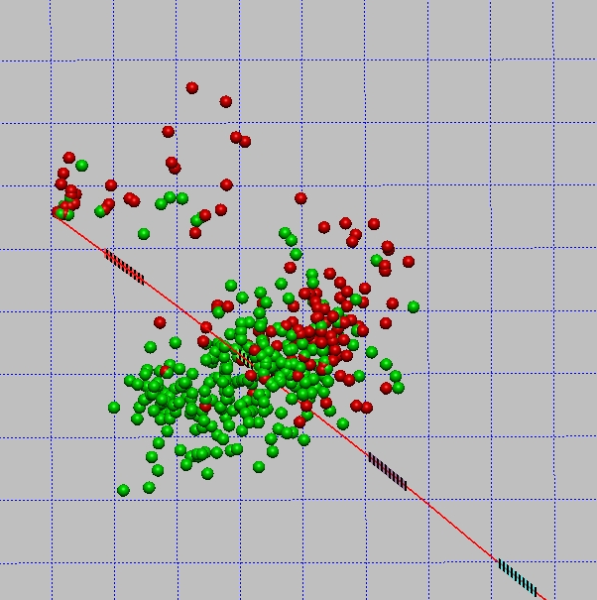
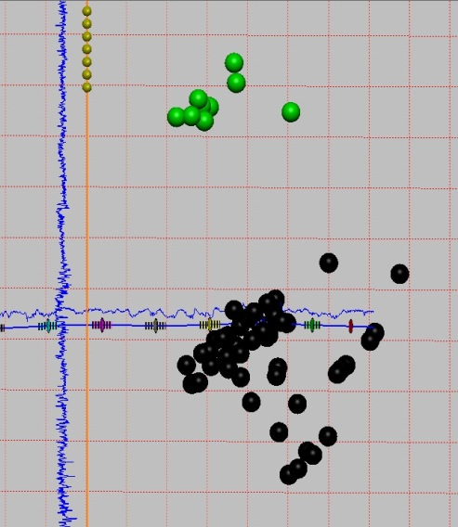
Out of Position Events Examples
Sleeve Failure
Disconnected Events

Slide 20
Event Frequency Comments
Conventional seismology suggests that event frequency is related to the magnitude size of the events.
  i.e. for every Mw = -2 event, there will be 10 Mw = -3 events. This is not commonly observed across the range of magnitudes due to signal attenuation, ambient noise, equipment limitation, etc.
Some wells will have more events than the adjacent well within the same formation on the same pad, treated with the same parameters.
Some stages will have more events than others. There is some debate on the nature of the fractures recorded. Are the events related to previously existing natural fractures? Are the events the result of bedding plane slip?

Slide 21
Symmetry Assumption
In the early days of frac modeling for designing a treatment program, the formations were often assumed to be isotropic and homogenous. As a result, symmetry was often assumed when not observed as the local geology at the finer scale was unknown.
As more hydraulic fracturing completions were monitored, the number of asymmetric projects observed increased and some projects featured both symmetric and asymmetric frac stages within the same well. Surface deployed monitoring techniques confirmed these results.
When reviewing a project it is necessary to consider monitor array bias as part of the interpretation.

Slide 22
Waveform Moveouts Review
The move-outs are a quick and easy way to evaluate the quality of the signal, well coupling/tool noise, and the location of the perforations/events for non-geophysicists
A noisy tool will have less signal relative to the adjacent tools, which could indicate a problem with the tool or the wellbore at that location
An event which is located in an unusual position can be verified that it was correctly migrated or picked, insuring the correct p-s wave pair was selected for processing
Events which are located high above the lateral, below the lateral and at the perforation depth should be reviewed to see if the patterns match the expected arrival. With a vertically deployed array straddling the well:
  events located at the perforation port should arrive in the center of the geophone array
  events located below the lateral should have the signal arriving on the bottom levels
  events located high or above the array should have the signal arriving first at the top geophones

Slide 23
Conclusion
Hydraulic fracture monitoring offers a robust solution with the highest degree of accuracy when performed correctly and when end-users are familiar with the processing steps and QC process
Different methods of data acquisition (borehole vs surface) will result in different biases, and each method has its advantages/disadvantages
Former hydraulic fracture (microseismic) processors (like me) make for an excellent independent QC step at a low cost.

Slide 24
About the Author
Kevin Burns
  is an independent microseismic consultant offering a low cost, high value approach to verifying your fracture completions
  former geophysical processing lead at Microseismic Inc., Weatherford International, and Pinnacle Technologies (Halliburton)
  Earned a MSc from the University of Tennessee - Knoxville, and BS from The University of Texas at Austin
See more at his website and blog at WWW.KEBURNS.COM

